Slide 1
Chapter 6: Synchronization Tools

Slide 2
Chapter 6: Synchronization Tools
Background
The Critical-Section Problem
Peterson’s Solution
Synchronization Hardware
Mutex Locks
Semaphores
Alternative Approaches

Slide 3
Objectives
To present the concept of process synchronization.
To introduce the critical-section problem, whose solutions can be used to ensure the consistency of shared data
To present both software and hardware solutions of the critical-section problem
To examine several classical process-synchronization problems
To explore several tools that are used to solve process synchronization problems

Slide 4
Synchronization
Concurrent access to shared data may result in data inconsistency
Maintaining data consistency requires mechanisms to ensure the orderly execution of cooperating processes
The synchronization mechanism is usually provided by both hardware and the operating system
Illustration of the problem – The producer-Consumer problem, which we introduced in Chapter 3.
Basic assumption – load and store instructions are atomic.

Slide 5
Producer-Consumer Problem
The Solution we presented in chapter 3 is correct, but can only use BUFFER_SIZE - 1 elements.
The methodology used is to allow only a single process to increment/decrement a particular shared variable.
There is a solution that fills all the buffers, using the same methodology:
  The producer process increments the value on the variable “in” (but not “out”) and the consumer process increments the value on the variable “’out” (but not “in”)
  The solution is more complex. Try and see if you can come up with the algorithm.

Slide 6
Producer-Consumer Problem (Cont.)
Suppose that we wanted to provide a solution that fills all the buffers where we allow the producer and consumer processes to increment and decrement the same variable.
We can do so by adding another integer variable -- counter that keeps track of the number of full buffers. Initially, counter is set to 0.
The variable counter It is incremented by the producer after it produces a new buffer and is decremented by the consumer after it consumes a buffer.
Code is shown in next two slides

Slide 7
Producer Process
while (true) {
/* produce an item in next produced */
while (counter == BUFFER_SIZE) ;
/* do nothing */
buffer[in] = next_produced;
in = (in + 1) % BUFFER_SIZE;
counter = counter +1;
}

Slide 8
Consumer Process
while (true) {
while (counter == 0)
; /* do nothing */
next_consumed = buffer[out];
out = (out + 1) % BUFFER_SIZE;
counter = counter - 1;
/* consume the item in next consumed */
}

Slide 9
Race Condition
counter = counter + 1 could be implemented as
register1 = counter
register1 = register1 + 1
counter = register1
counter = counter -1 could be implemented as
register2 = counter
register2 = register2 - 1
counter = register2
Consider this execution interleaving with “count = 5” initially:
  S0: producer execute register1 = counter {register1 = 5}
  S1: producer execute register1 = register1 + 1 {register1 = 6}
  S2: consumer execute register2 = counter {register2 = 5}
  S3: consumer execute register2 = register2 – 1 {register2 = 4}
  S4: producer execute counter = register1 {counter = 6 }
  S5: consumer execute counter = register2 {counter = 4}

Slide 10
Race Condition (Cont.)
How do we solve the race condition?
We need to make sure that:
  The execution of
  counter = counter + 1
  is executed as an “atomic” action. That is, while it is being executed, no other instruction can be executed concurrently.
  Similarly for
  counter = counter - 1
The ability to execute an instruction, or a number of instructions, atomically is crucial for being able to solve many of the synchronization problems.

Slide 11
Critical Section Problem
Consider system of n processes {P₀, P₁, … P_{n-1}}
Each process has critical section segment of code
  Process may be changing common variables, updating table, writing file, etc
  When one process in critical section, no other may be in its critical section
Critical section problem is to design protocol to solve this
Each process must ask permission to enter critical section in entry section code; it than executes in the critical section; once it finishes executing in the critical section it enters the exit section code. The process then enters the remainder section code.

Slide 12

General structure of Process Entering the Critical Section
General structure of process P_{i}

Slide 13
Algorithm for Process P_{i}
Entry section to critical section is to “disable interrupts.
Execute in the critical section
Exit section is to “enable interrupts”.
Implementation issues:
  Uniprocessor systems
    Currently running code would execute without preemption
  Multiprocessor systems.
    Generally too inefficient on multiprocessor systems
    Operating systems using this not broadly scalable
Is this an acceptable solution?
  This is impractical if the critical section code is taking a long time to execute.

Slide 14
Algorithm for Process P_{i}
Keep a variable “turn” to indicate which process is next
do {
while (turn == j);
critical section
turn = j;
remainder section
} while (true);
Algorithm is correct. Only one process at a time in the critical section. But:
Results in “busy waiting”.
If P_{i} wants to enter then critical section and turn = j and P_{j} does not want to enter the critical section ….

Slide 15
Algorithm for Process P_{i}
Have a variable “turn” to indicate which process is next
do {
while (turn == j);
critical section
turn = j;
remainder section
} while (true);
Algorithm is correct. Only one process at a time in the critical section. But….
Busy waiting

Slide 16
Solution to Critical-Section Problem
1. Mutual Exclusion - If process P_{i} is executing in its critical section, then no other processes can be executing in their critical sections
2. Progress - If no process is executing in its critical section and there exist some processes that wish to enter their critical section, then the selection of the processes that will enter the critical section next cannot be postponed indefinitely
3. Bounded Waiting - A bound must exist on the number of times that other processes are allowed to enter their critical sections after a process has made a request to enter its critical section and before that request is granted
  Assume that each process executes at a nonzero speed
  No assumption concerning relative speed of the n processes

Slide 17
Software Solution: Peterson’s Algorithm
Good algorithmic software solution
Two process solution
Assume that the load and store machine-language instructions are atomic; that is, cannot be interrupted
The two processes share two variables:
  int turn;
  Boolean flag[2]
The variable turn indicates whose turn it is to enter the critical section
The flag array is used to indicate if a process is ready to enter the critical section. flag[i] = true implies that process P_{i} is ready!

Slide 18
Algorithm for Process P_{i}
do {
flag[i] = true;
turn = j;
while (flag[j] && turn = = j);
critical section
flag[i] = false;
remainder section
} while (true);

Slide 19
Peterson’s Solution (Cont.)
Provable that the three CS requirement are met:
1. Mutual exclusion is preserved
P_{i} enters CS only if:
either flag[j] = false or turn = i
2. Progress requirement is satisfied
3. Bounded-waiting requirement is met
What about a solution to N > 2 processes

Slide 20
Solution to Critical-section Problem Using Locks
Many systems provide hardware support for implementing the critical section code.
All solutions are based on idea of locking
  Protecting critical regions via locks
Code:
do {
critical section
remainder section
} while (TRUE);
acquire lock
release lock

Slide 21
Synchronization Hardware
Modern machines provide special atomic hardware instructions to implement locks
  Atomic = non-interruptible
Two types instructions:
  Test memory word and set value
  Swap contents of two memory words

Slide 22
test_and_set Instruction
Definition:
boolean test_and_set (boolean *target)
{
boolean rv = *target;
*target = TRUE;
return rv:
}
Properties:
  Executed atomically
  Returns the original value of passed parameter
  Set the new value of passed parameter to “TRUE”.

Slide 23
Solution using test_and_set()
Shared Boolean variable lock, initialized to FALSE
Each process, wishing to execute CS code:
do {
while (test_and_set(&lock))
; /* do nothing */
/* critical section */
lock = false;
/* remainder section */
} while (true);
Solution results in busy waiting.
What about bounded waiting?

Slide 24
Bounded-waiting Mutual Exclusion with test_and_set
do {
waiting[i] = true;
key = true;
while (waiting[i] && key)
key = test_and_set(&lock);
waiting[i] = false;
/* critical section */
j = (i + 1) % n;
while ((j != i) && !waiting[j])
j = (j + 1) % n;
if (j == i)
lock = false;
else
waiting[j] = false;
/* remainder section */
} while (true);

Slide 25
compare_and_swap Instruction
Definition:
int compare_and_swap(int *value, int expected, int new_value) {
int temp = *value;
if (*value == expected)
*value = new_value;
return temp;
}
Properties:
  Executed atomically
  Returns the original value of passed parameter “value”
  Set “value” to “new_value ” but only if “value” == “expected”.
  That is, the swap takes place only under this condition.

Slide 26
Solution using compare_and_swap
Shared integer “lock” initialized to 0;
Solution:
do {
while (compare_and_swap(&lock, 0, 1) != 0)
; /* do nothing */
/* critical section */
lock = 0;
/* remainder section */
} while (true);
Solution results in busy waiting.
What about bounded waiting?

Slide 27
Mutex Locks
Previous solutions are complicated and generally inaccessible to application programmers
OS designers build software tools to solve critical section problem
Simplest tools is the mutex lock, which has a Boolean variable “available” associated with it to indicate if the lock is available or not.
Two operations available to access a Mutex lock:
  acquire() {
  while (!available)
  ; /* busy wait */
  available = false;
  }
  release() {
  available = true;
}

Slide 28
Mutex Locks (Cont.)
Calls to acquire() and release() must be atomic
  Usually implemented via hardware atomic instructions
Usage:
do {
acquire lock
critical section
release lock
remainder section
} while (true);
Solution requires busy waiting
  This lock is therefore called a spinlock

Slide 29
Semaphores
Synchronization tool that provides more sophisticated ways (than Mutex locks) for processes to synchronize their activities.
Semaphore S – integer variable
Can only be accessed via two indivisible (atomic) operations
  wait() and signal()
    Originally called P() and V()
Definition of the wait()operation
  wait(S) {
  while (S <= 0)
  ; // busy wait
  S = S - 1;
  }
Definition of the signal() operation
  signal(S) {
  S = S + 1;
  }

Slide 30
Semaphore Usage
Can solve various synchronization problems
A solution to the CS problem.
  Create a semaphore “synch” initialized to 1
  wait(synch)
  CS
  signal(synch);
Consider P₁ and P₂ that require code segment S₁ to happen before code segment S₂
  Create a semaphore “synch” initialized to 0
  P1:
  S₁;
  signal(synch);
  P2:
  wait(synch);
  S₂;

Slide 31
Types of Semaphores
Counting semaphore – integer value can range over an unrestricted domain
Binary semaphore – integer value can range only between 0 and 1
  Same as a mutex lock
Can implement a counting semaphore S as a binary semaphore

Slide 32
Counting Semaphores Example
Allow at most two process to execute in the CS.
Create a semaphore “synch” initialized to 2
wait(synch)
CS
signal(synch);

Slide 33
Semaphore Implementation
Must guarantee that no two processes can execute the wait() and signal() on the same semaphore at the same time
Thus, the implementation becomes the critical section problem where the wait and signal code are placed in the critical section
This implementation is based on busy waiting in critical section implementation (that is, the code for wait() and signal())
  But implementation code is short
  Little busy waiting if critical section rarely occupied
Can we implement semaphores with no busy waiting?

Slide 34
Semaphore Implementation with no Busy Waiting
With each semaphore there is an associated waiting queue
Each entry in a waiting queue has two data items:
  value (of type integer)
  pointer to next record in the list
typedef struct{
int value;
struct process *list;
} semaphore;
Two operations:
  block – place the process invoking the operation on the appropriate waiting queue
  wakeup – remove one of processes in the waiting queue and place it in the ready queue

Slide 35
Implementation with no Busy waiting (Cont.)
wait(semaphore *S) {
S->value--;
if (S->value < 0) {
add this process to S->list;
block();
}
}
signal(semaphore *S) {
S->value++;
if (S->value <= 0) {
remove a process P from S->list;
wakeup(P);
}
}

Slide 36
Implementation with no Busy waiting (Cont.)
Does the implementation ensure the “progress” requirement?
Does implementation ensure the “bounded waiting” requirement?

Slide 37
Deadlock and Starvation
Deadlock – two or more processes are waiting indefinitely for an event that can be caused by only one of the waiting processes
Let S and Q be two semaphores initialized to 1
P₀ P₁
wait(S); wait(Q);
wait(Q); wait(S);
... ...
signal(S); signal(Q);
signal(Q); signal(S);
Starvation – indefinite blocking
  A process may never be removed from the semaphore queue in which it is suspended
Priority Inversion – Scheduling problem when lower-priority process holds a lock needed by higher-priority process
  Solved via priority-inheritance protocol

Slide 38
Problems with Semaphores
Incorrect use of semaphore operations:
  signal (mutex) …. wait (mutex)
  wait (mutex) … wait (mutex)
  Omitting of wait (mutex) or signal (mutex) (or both)
Deadlock and starvation are possible.
Solution – create high-level programming language constructs

Slide 39
Monitors
A high-level abstraction that provides a convenient and effective mechanism for process synchronization
Abstract data type, internal variables only accessible by code within the procedure
Only one process may be active within the monitor at a time
    monitor monitor-name
    {
    // shared variable declarations
    procedure P1 (…) { …. }
    procedure Pn (…) {……}
    Initialization code (…) { … }
    }
    }
Mutual exclusion is guaranteed by the compiler.

Slide 40

Schematic view of a Monitor

Slide 41
Condition Variables
Need mechanism to allow a process wait within a monitor
Provide condition variables.
A condition variable (say x) can be accessed only via two operations:
  x.wait() – a process that invokes the operation is suspended until another process invoked x.signal()
  x.signal() – resumes one of processes (if any) that invoked x.wait()
    If no process is suspended on variable x , then it has no effect on the variable

Slide 42

Monitor with Condition Variables

Slide 43
Condition Variables Choices
If process P invokes x.signal(), and process Q is suspended in x.wait(), what should happen next?
  Both Q and P cannot execute in parallel. If Q is resumed, then P must wait
Options include:
  Signal and wait – P either waits until Q leaves the monitor or it waits for another condition
  Signal and continue – Q either waits until P leaves the monitor or it waits for another condition

Slide 44
Condition Variables Choices (Cont.)
There are reasonable arguments in favor of adopting either option.
  Since P was already executing in the monitor, the signal-and-continue method seems more reasonable.
  However, if we allow P to continue, by the time Q is resumed, the logical condition for which Q was waiting may no longer hold.
A compromise between these two choices was adopted in the language Concurrent Pascal. When P executes the signal operation, it immediately leaves the monitor. Hence, Q is immediately resumed.

Slide 45
Languages Supporting the Monitor Concept
Many programming languages have incorporated the idea of the monitor as described in this section, including Java and C#.
Other languages such as Erlang provide concurrency support using a similar mechanism.

Slide 46
Monitor Implementation
For each monitor, a semaphore mutex is provided.
A process must execute wait(mutex) before entering the monitor and must execute signal(mutex) after leaving the monitor. This is ensured by the compiler.
  We use the “signal and wait” mechanism to handle the signal operation.
Since a signaling process must wait until the resumed process either leaves or it waits, an additional semaphore, next, is used.
The signaling processes can use next to suspend themselves.
An integer variable next_count is provided to count the number of processes suspended on next

Slide 47
Monitor Implementation (Cont.)
Variables
semaphore mutex; // (initially = 1)
semaphore next; // (initially = 0)
int next_count = 0;
Each procedure F will be replaced by
wait(mutex);
…
body of F;
…
if (next_count > 0)
signal(next)
else
signal(mutex);
Mutual exclusion within a monitor is ensured

Slide 48
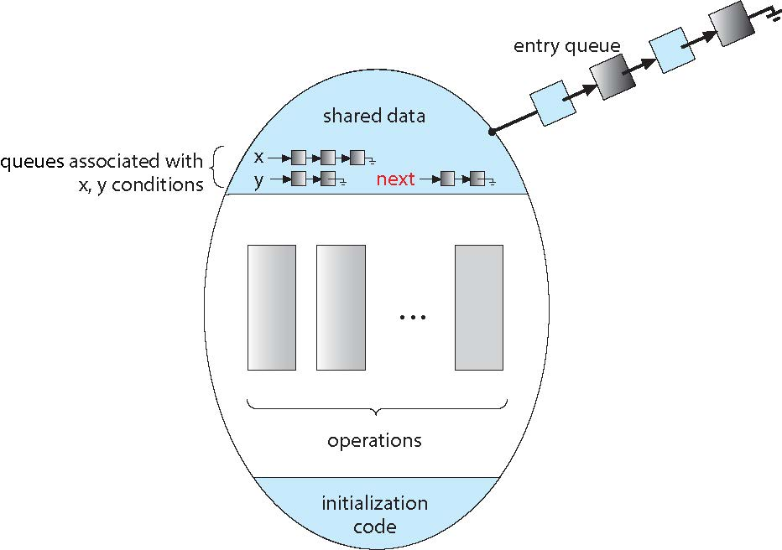
Monitor with Next Semaphore

Slide 49
Condition Variables Implementation
For each condition variable x, we have:
semaphore x_sem; // (initially = 0)
int x_count = 0;
The operation x.wait can be implemented as:
x_count++;
if (next_count > 0)
signal(next);
else
signal(mutex);
wait(x_sem);
x_count--;

Slide 50
Condition Variables Implementation (Cont.)
The operation x.signal can be implemented as:
if (x_count > 0) {
next_count++;
signal(x_sem);
wait(next);
next_count--;
}

Slide 51
Resuming Processes within a Monitor
If several processes queued on condition x, and x.signal() is executed, which one should be resumed?
FCFS frequently not adequate
conditional-wait construct of the form x.wait(c)
  Where c is priority number
  Process with lowest number (low number ➔ highest priority) is scheduled next
Some languages provide a mechanism to find out the PID of the executing process.
  In C we have getpid(), which retunes the PID of the calling process

Slide 52
Resource Allocator Monitor Example
A monitor to allocate a single resource among competing processes
Each process, when requesting an allocation of this resource, specifies the maximum time it plans to use the resource. The monitor allocates the resource to the process that has the shortest time-allocation request.
monitor ResourceAllocator
{
boolean busy;
    condition x;
    void acquire(int time) {
    if (busy)
    x.wait(time)
    busy = true;
    }
    void release () {
    busy = false;
    x.signal();
    }
    busy= false;
    }

Slide 53
Resource Allocator Monitor Example (Cont.)
A process that needs to access the resource in question must observe the following sequence:
    R.acquire(t);
    . . .
    access the resource;
    . . .
    R.release();
where R is is an instance of type ResourceAllocator

Slide 54
Observation the Resource Allocator Example
Incorrect use of the operations:
  R.release …. R.acquire(t)
  R.acquire(t) .… R.acquire(t)
  Omitting of acquire and or release (or both)
Solution exist but not covered in this course

Slide 55
End of Chapter 6

